Slide 1
Taking India to MARS
The Story behind India’s space programme
Ted talk by Ritu Karidhal,
Deputy Operations Director,ISRO

Slide 2
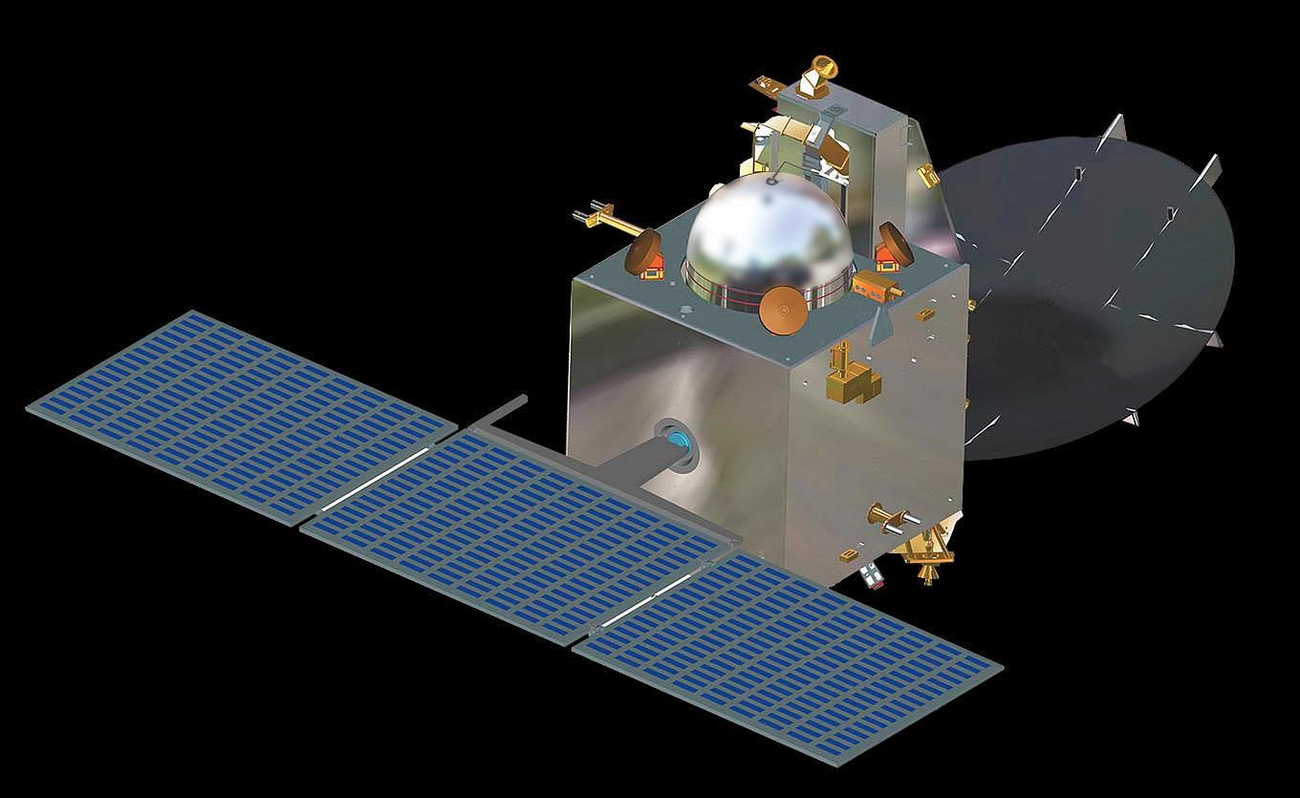
MOM
Mars Orbiter Mission

Slide 3
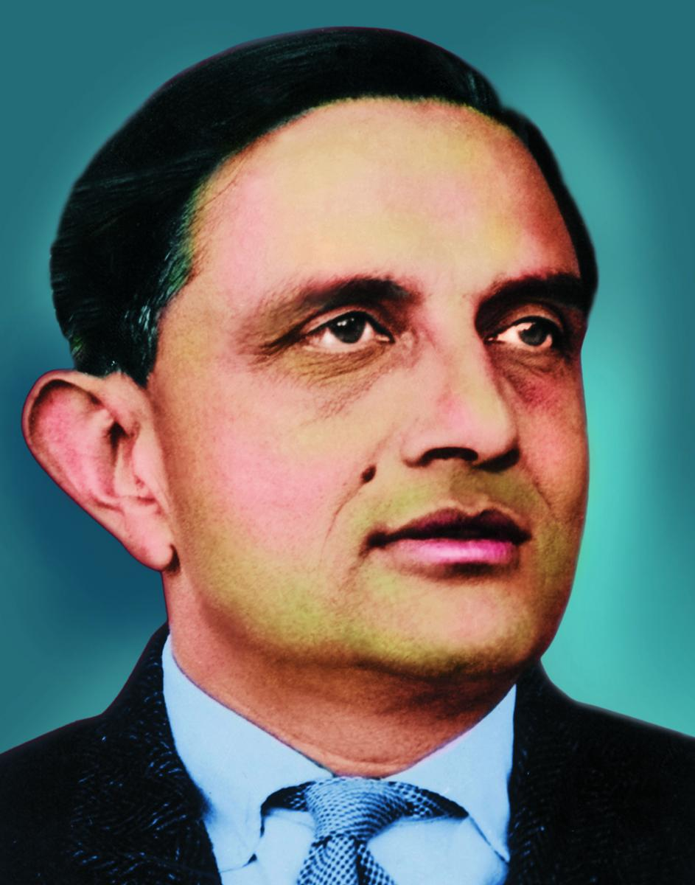
History
ISRO
Dr. Vikram Sarabhai
1960

Slide 4
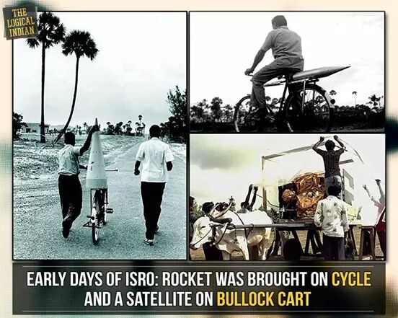
Earlier Days

Slide 5
Facts about Mars
Min distance - 54.6 million km
Max distance – 401 million km
Year span- 687 earth days
2 satellites- Phobos and Deimos
Size is half of the earth
20 min needed to reach a signal to mars

Slide 6
Stages MOM
Launch date- 5th Nov, 2013
1st Stage - Launch
2nd Stage - Sending out of the earth orbit
3rd Stage – Injecting it to the Mars orbit
Reached Mars on 24th Sept, 2014

Slide 7
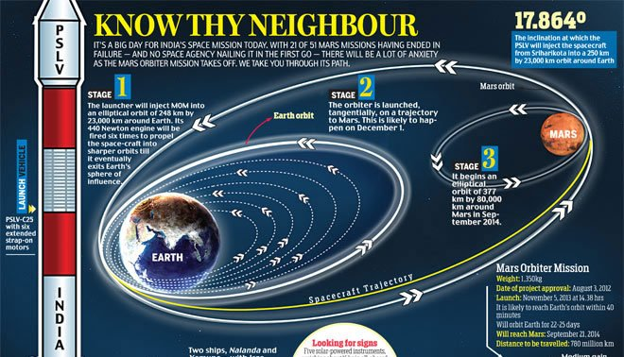
Trajectory

Slide 8
Facts about MOM
First mission to succeed in first attempt
Most economical interplanetary mission
Shortest period of 18 months
Full scale onboard autonomy
Youngest team

Slide 9
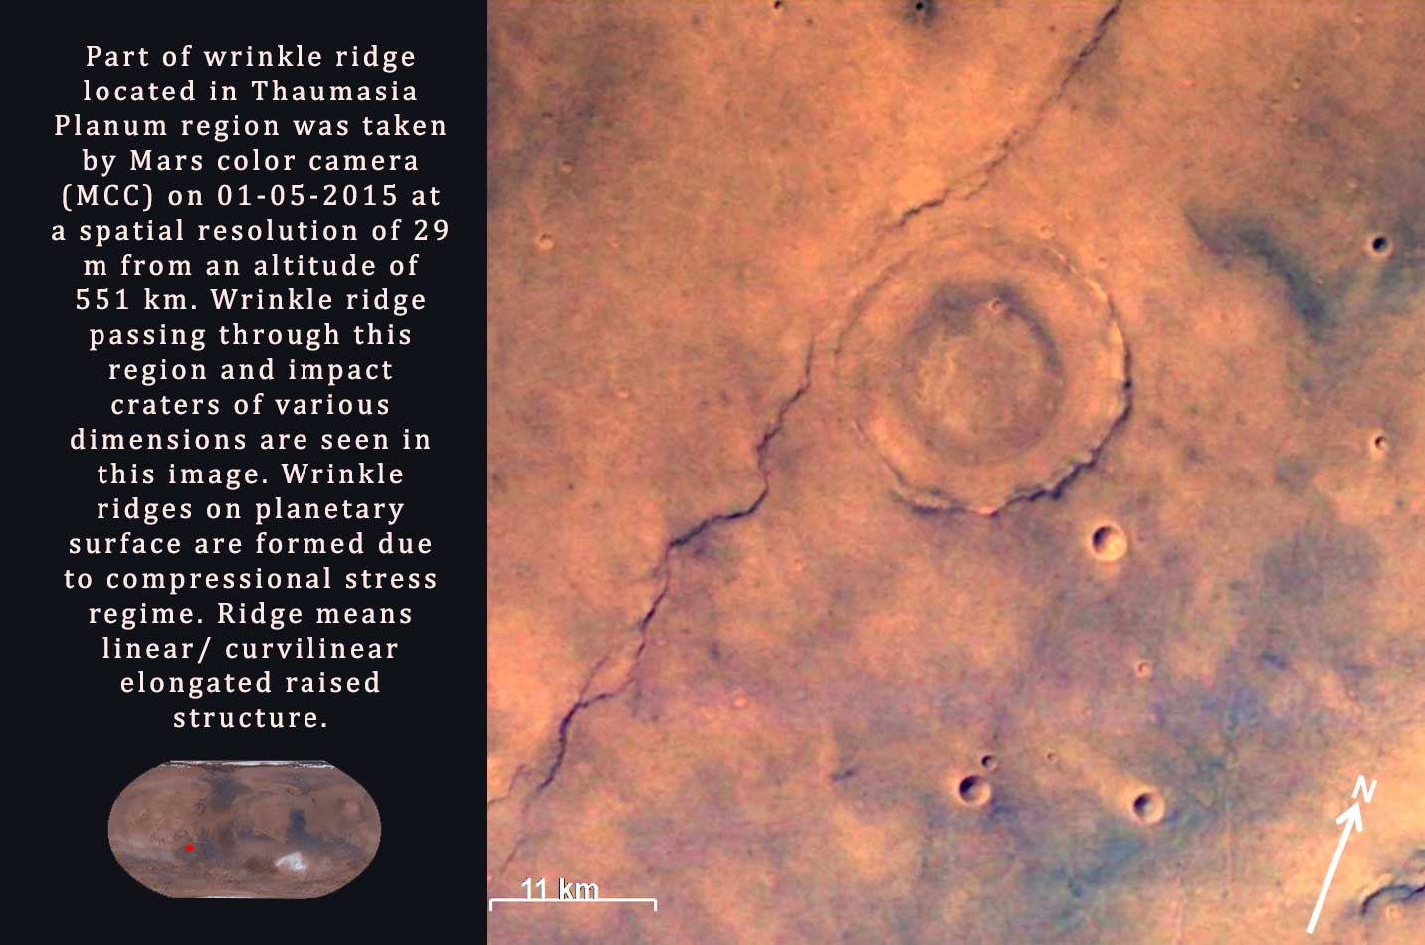

Slide 10
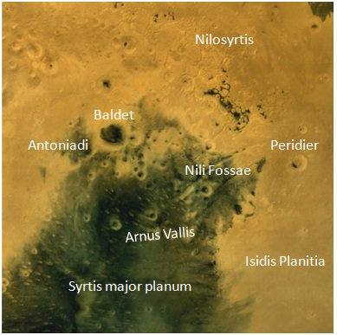

Slide 11
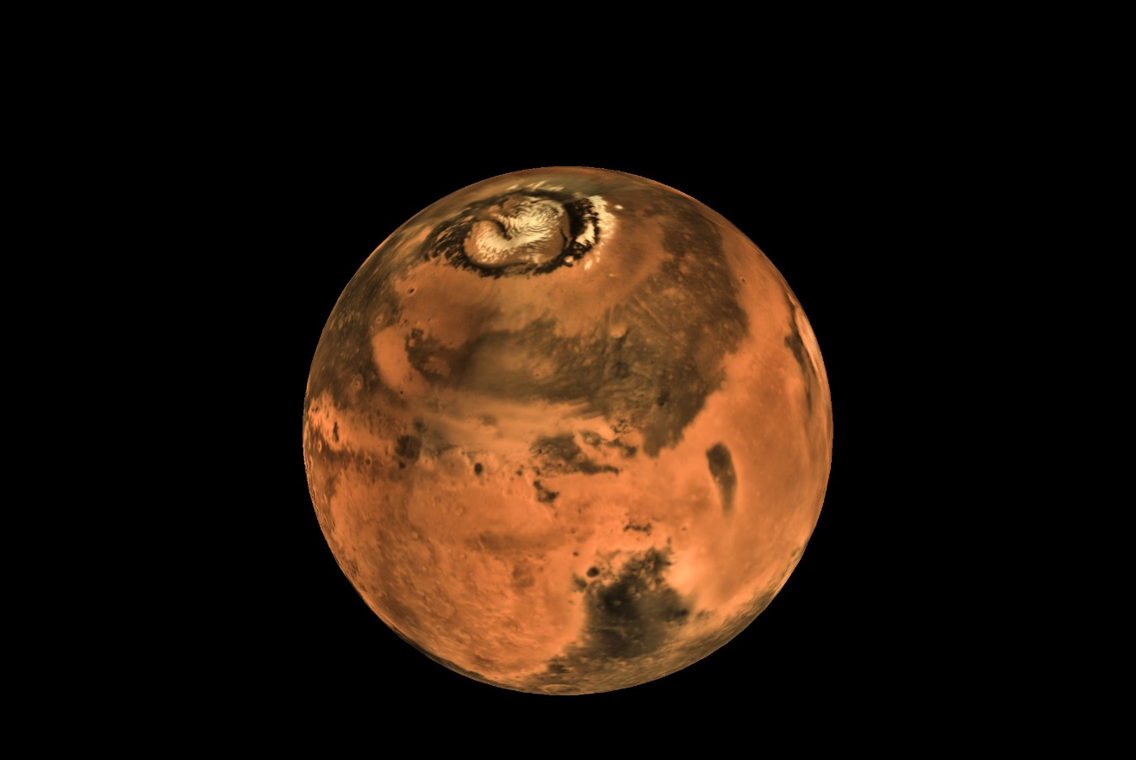

Slide 12
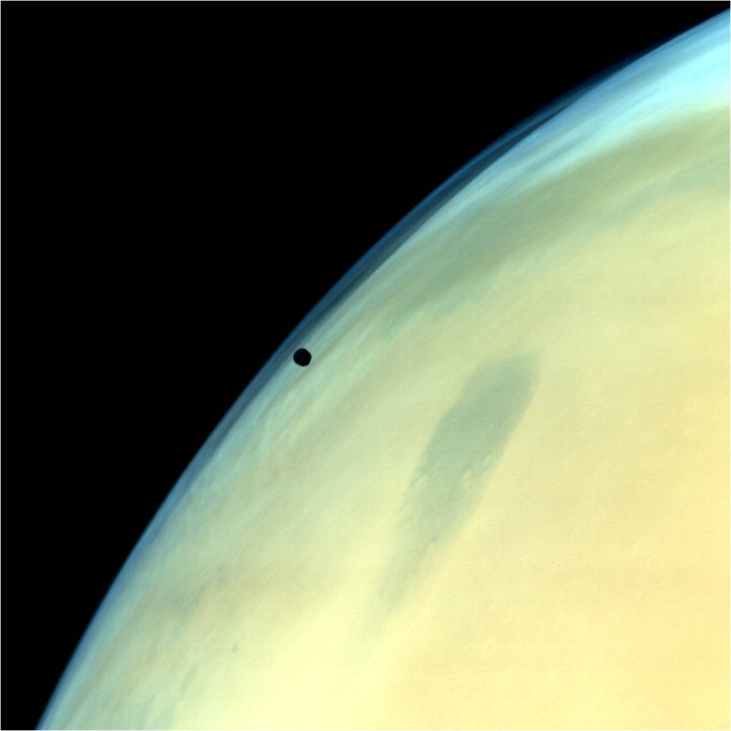

Slide 13
Conclusion
It’s not the money but the hard-work, determination, sincerity and farsightedness of an organization, important for success.
Thanks !

